Slide 1
UNIT-5
DEPLOYING AND CONFIGURING SSIS PACKAGES, CONSUMING DATA IN DATA WAREHOUSE

Slide 2
Overview of SSIS Development :
SQL Server Integration Services (SSIS) is a platform for building high performance data integration and workflow solutions.
It allows creation of packages or SSIS packages which are made up of tasks that can move data from source to destination and alter it if required.
SSIS is basically an ETL (Extraction, Transformation, and Load) tool whose main purpose is to do extraction, transformation and loading of data but it can be used for several other purposes, for example, to automate maintenance of SQL Server databases, update multidimensional cube data or send e-mails detailing the status of the operation as defined by the user.

Slide 3
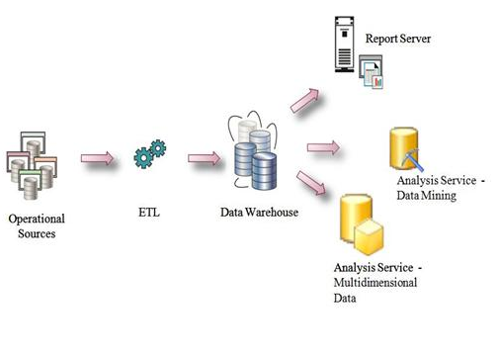

Slide 4
Typical Use of Integration Services
Merging Data from Heterogeneous Data Stores
Populating Data Warehouses and Data Marts
Cleaning and Standardizing Data
Building Business Intelligence into a Data Transformation Process
Automating Administrative Functions and Data Loading

Slide 5
Package
Packages are the root of the hierarchy. Although an SSIS solution can contain a number of packages, they are not held, logically or physical, in any kind of container.
Container
The level beneath the package can be either a container or some kind of executable (a Control Flow executable). A container is a logical construct that can hold other containers or components grouped together under the “super-container.”

Slide 6
Variables
SSIS provides support for strongly typed part–Common Type System (CTS)–compliant variables as a part of any container or package.
Scope
Scope refers to the visibility and usability of a variable to a piece of code, based on where in the code the variable is defined. For example, a variable with global scope is defined at package level and is visible to and usable by any package, container, or component in the hierarchy beneath it. By contrast, a variable defined at Data Flow task level is visible only to that task and its subtasks.

Slide 7
Precedence constraints
Control Flow design surface may have multiple Control Flow items, in this situation we need to decide which item will execute first. Using Precedence Constraints, we can define processing flow for Control Flow items. We can define different flow based on success or failure of any item.
Event Handlers
Event handlers are offered at most levels of the package hierarchy. The types of event handlers differ depending upon the type of object against which you want to handle events.

Slide 8
SSIS Architecture:
Microsoft SQL Server Integration Services (SSIS) consist of four key parts:
SSIS Service
SSIS Object Model
SSIS runtime engine and the runtime executables
SSIS dataflow engine and the dataflow components

Slide 9
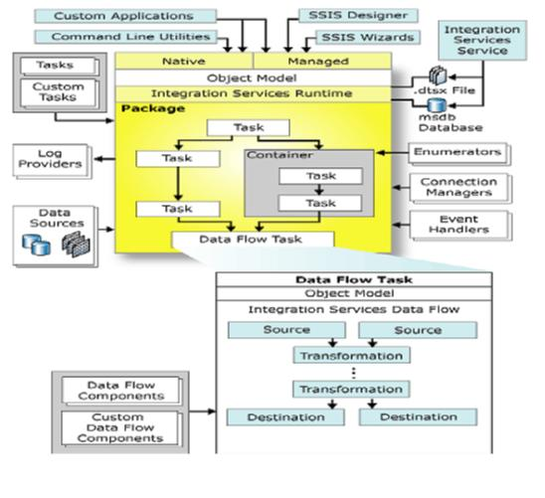

Slide 10
Deploying SSIS Projects:
Deployment: Methodical procedure of introducing an activity, process, program, or system to all applicable areas of an organization.
In short, Deploying is nothing but moving something from one place to another place.
The project deployment model enables you to deploy your projects to the Integration Services server.
Steps for deploying Project:
Step-1:
In order to understand deployment completely first we need to see what will get deployed to production server.

Slide 11
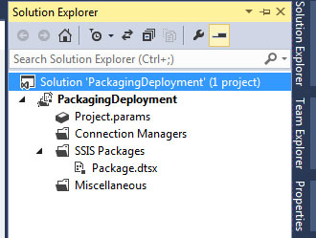

Slide 12
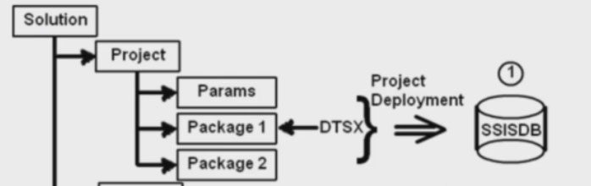
It shows how solution of a SSIS project is structured if you see above image there is a solution -> project -> parameters & package -> Package.dtsx as shown in below image.
So when we do package depolyment all this files gets uploaded to production server (SQL SERVER SSISDB).

Slide 13
Step-2:
This is optional step but still if any one doesn't have SSISDB in their SQL Server for them it is useful. Open your SQL Management Studio and Find Integration Services Catalogs -> right click and create catalog -> Check Enable CLR Integration to ensure smooth running of catalog -> Type your password and save it.
This will create your SSISDB catalog under Integration Services Catalogs.

Slide 14
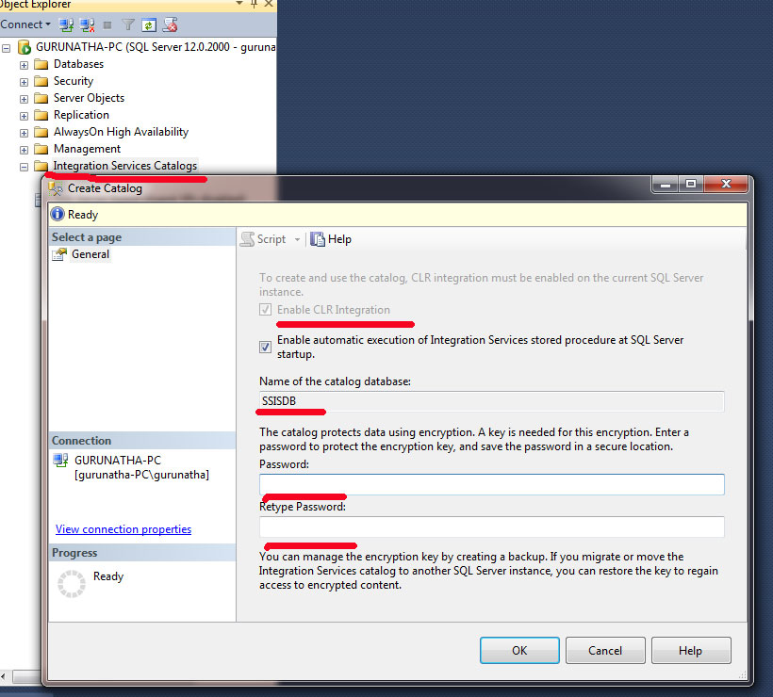

Slide 15
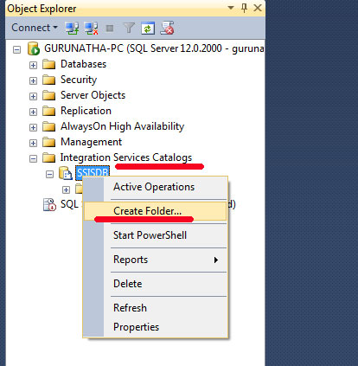
Step-3
Once your SSISDB catalog is ready just right click on that and create folder why because to save our deployment files we need a folder under SSISDB catlog.

Slide 16
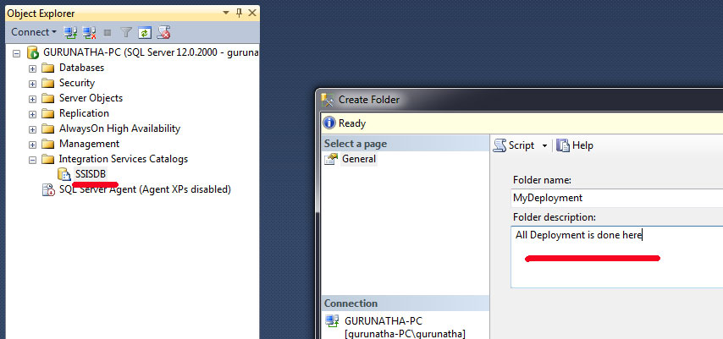
As you see we have successfully created a folder under SSISDB. Now this will our place to store deployment project.

Slide 17
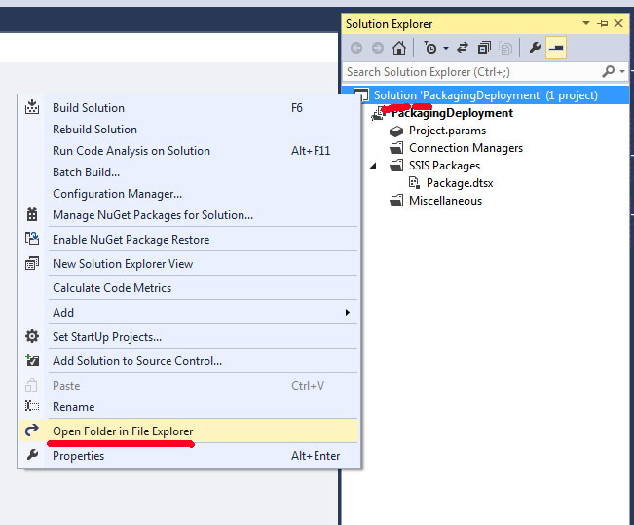
Step-4:
Now go to SSIS project and go to solution explorer do the steps as shown in below image.

Slide 18
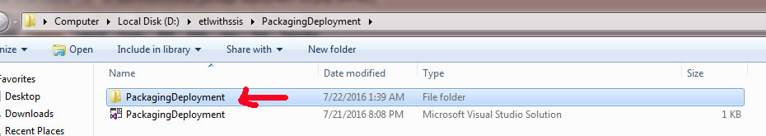
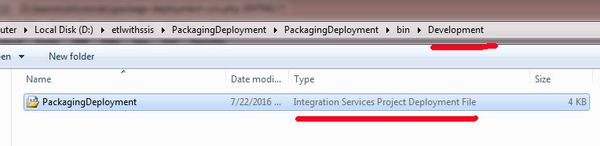
After clicking you will be navigated to filde containing folder inside there will a Microsoft Visual Studio Solution and a Folder as shown in below image.
Now inside that folder -> Bin Folder -> Development Folder -> PackagingDeployment (Integration Services Project Development File). If you see its property it is also called as .ispac extension file.

Slide 19
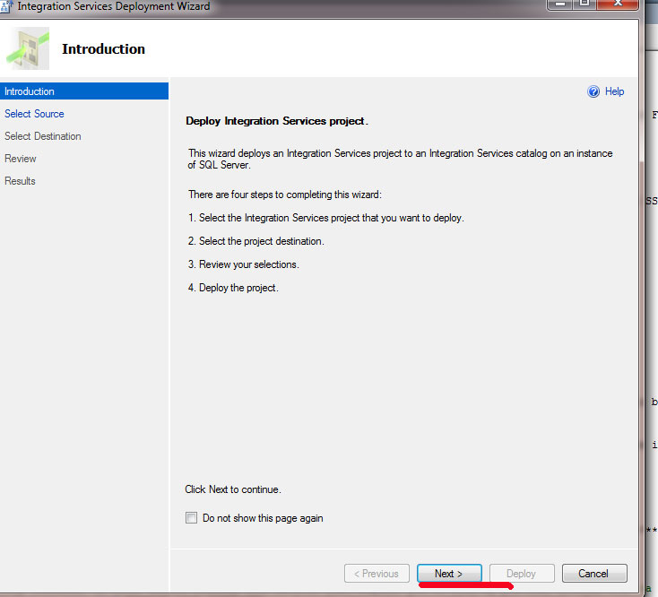
Just double click on it an Integration Service Wizard will open up wizard.click on next

Slide 20
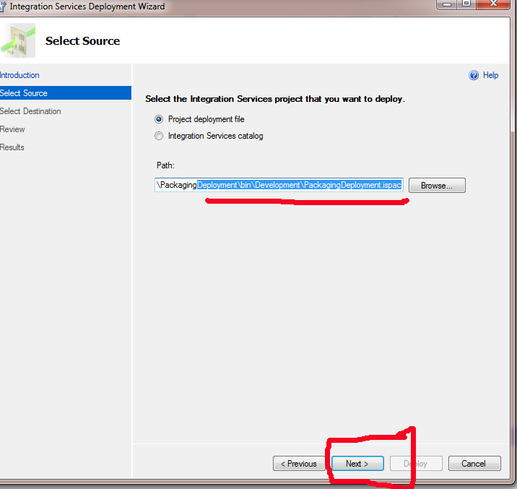

Slide 21
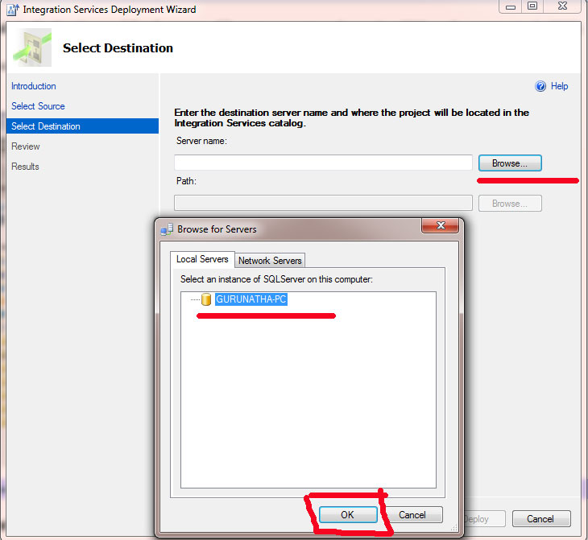

Slide 22
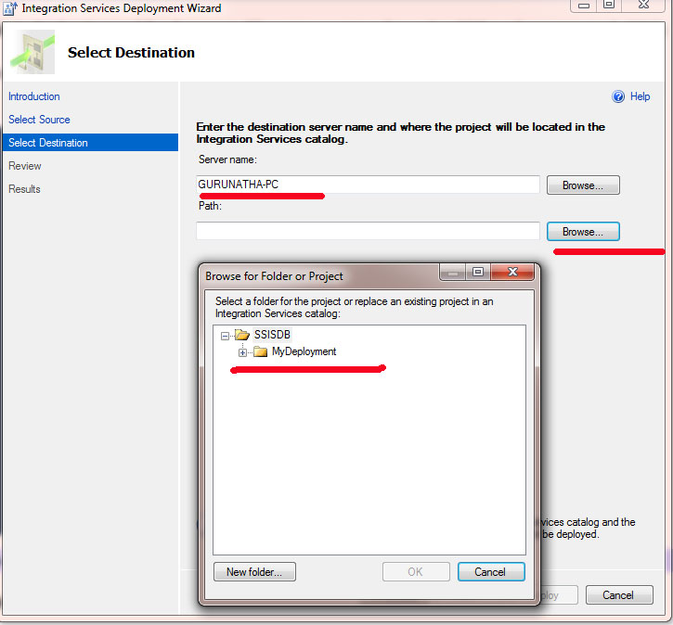

Slide 23
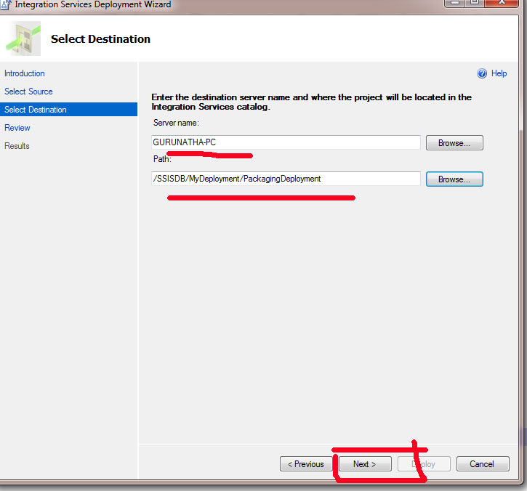
Once your server is selected next thing we need to select path the path is nothing but the folder which we have created under SSISDB catalog.

Slide 24
Select the SSISDB catalog folder path and click on next step to review deployment.

Slide 25
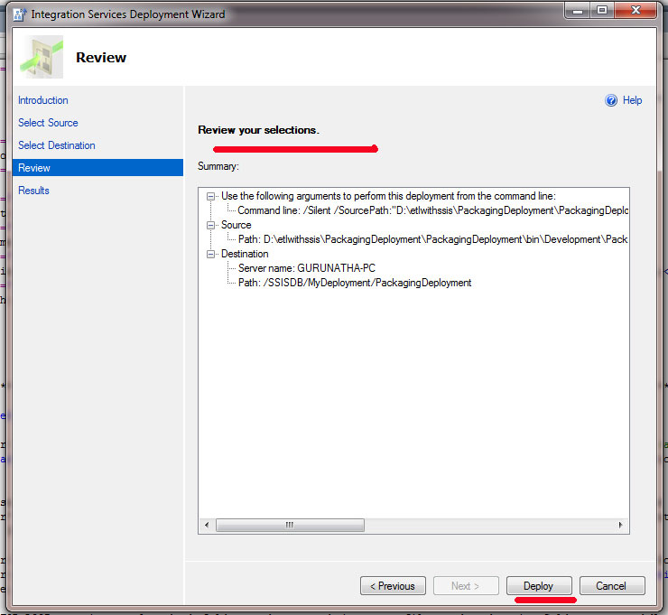

Slide 26
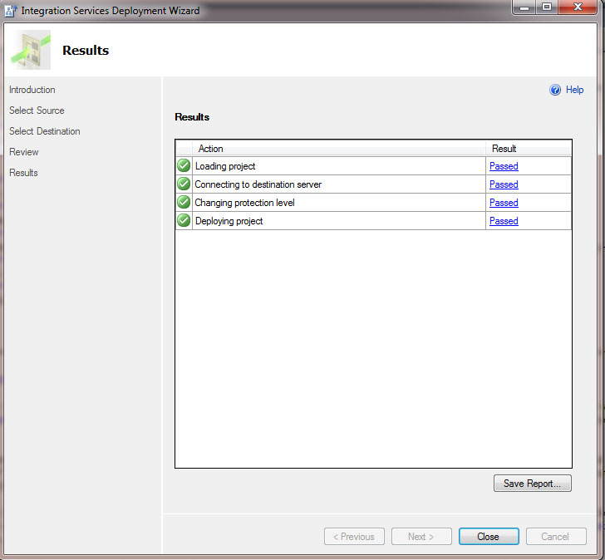
Finally click on Deploy button to deploy the package.

Slide 27
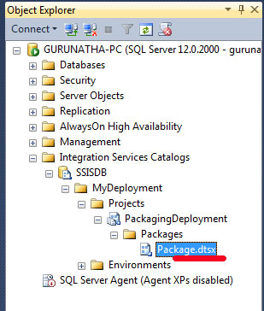
Step-5
Go to SQL Server Management Studio -> SSISDB Catalog -> MyDeployment. To check deployment is processed successfully or not.

Slide 28
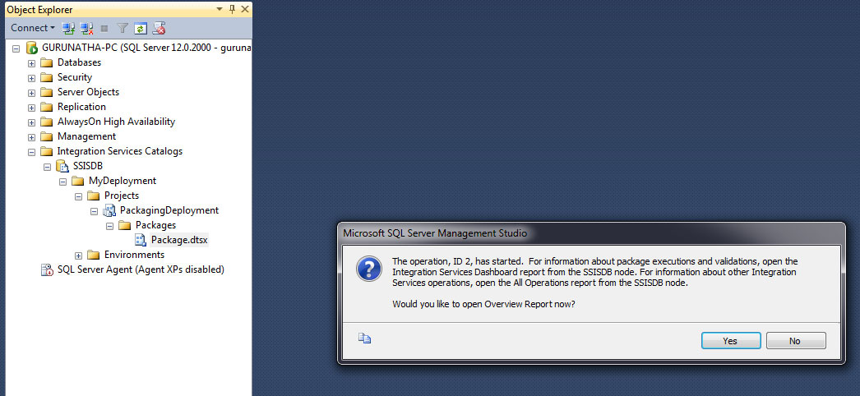
Step-6
Now just right click on .dtsx and Execute the project .

Slide 29
Planning SSIS Package Execution:
Integration Services includes tasks that perform workflow operations, such as executing executables and batch files.
You can use the Execute Package task for the following purposes:
->Breaking down complex package workflow
->Reusing parts of packages
->Grouping work units
-> Controlling package security

Slide 30
The Execute Package task can run child packages that are contained in the same project that contains the parent package.
You select a child package from the project by setting the ReferenceType property to Project Reference, and then setting the PackageNameFromProjectReference property.
The Execute Package task can also run packages stored in the SQL Server msdb database and packages stored in the file system.
The task uses an OLE DB connection manager to connect to SQL Server or a File connection manager to access the file system.

Slide 31
The Execute Package task can also run a database maintenance plan, which lets you manage both SSIS packages and database maintenance plans in the same Integration Services solution. A database maintenance plan is similar to an SSIS package, but a plan can include only database maintenance tasks, and it is always stored in the msdb database.

Slide 32
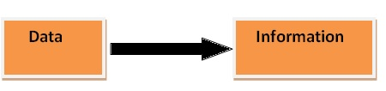
Introduction to Business Intelligence :
Business intelligence or BI is nothing but its process of converting data into information.
Business Intelligence is techniques for transforming data into information. This information helps to make quick decisions.
Data and information meaning look like similar but both are different, data is a technical format.
Data is row material for analysis. Data is always related to transactions or events. Once the data is analyzed it's considered to be meaningful information.

Slide 33
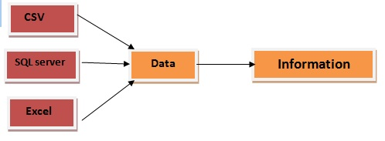
If we have data in *CSV, SQL server and Excel. So data is the technical word and if you ask the end user to understand this technical thing is very difficult. So we have to take this all technical format and presented to the user in a very user-friendly way so that we can understand that data and make meaning out of the data.
So BI is nothing but the process of transforming the technical data into user understandable information.

Slide 34
MSBI Tools:
Microsoft provides some tools to transform your business data into information. We can use these tools with the interface of Visual Studio.
With the release of SQL Server 2012, Business Intelligence Development Studio (BIDS) was renamed to SQL Server Data Tools (SSDT).
Why MSBI?
MSBI allows data storing and fetching for elegant processing and fast decisions in business
It consists resource tools provides the solutions for business intelligence
The most of the companies are searching for expert business intelligent workers and require for SSAS, SSIS and SSRS Professionals is increasing recently
We can learn complete package as mentioned SQL server and data tools

Slide 35
List of ETL tools:
SQL Server Integration Service (SSIS)
SQL Server Analysis Service (SSAS)
SQL Server Reporting Service(SSRS)

Slide 36
Introduction to Reporting :
Microsoft SQL Server Reporting Services (SSRS) is an enterprise reporting platform supporting traditional and interactive reports delivered over the web or through custom applications. It supports various data sources like two dimensional and multi-dimensional.
The following are some features of SSRS:
Retrieve data from different source
Web based access to reports
Support for Ad-hoc reporting
Report builder helps to customize the reports for end user.
Easy subscriptions options
Export functionality with lots of format.
Display reports in various ways like tabular, chart, Gauge and so on.

Slide 37
Advantages of reporting service (SSRS):
Below are some of the top advantages of reporting service:
1.Easy to deploy
2.Easy export for further analysis with multiple file formats
3.Report will run based on your timing via Report Subscription
4.Dig-Drill reporting
5.Normal Intuitive display options
6. Windows Security in SSRS

Slide 38
1.Easy to deploy: Reports are centralized, users can run reports from one place and having centralized reports also means that report deployment is quite simple.
2.Easy export for further analysis with multiple file formats: SSRS supports rendering to most common file formats including HTML, PDF, CSV, XML, and Image and also offers complete rendering in Microsoft Office Word and Microsoft Office Excel.

Slide 39
3.Report will run based on your timing via Report Subscription: SSRS supports standard as well as data-driven subscriptions, enabling the automatic delivery of reports to the right users by pushing them directly to each user via email or by sending them to a file share from where users can pull the reports. Users can use standard subscriptions to have reports delivered to them based on a custom schedule and specified report parameter values.
4.Dig-Drill reporting: Without any kind of change, customization or programming, users can easily seamlessly drill through any combination of data in the database.

Slide 40
5.Normal Intuitive display options: Every time Users have different requirements and expectations whenever they viewing and interacting with reports, and a report format always works well for one kind of data that might not be appropriate for other kinds of data. SSRS supports a number of display options, enabling you to create reports that display data in the most suitable layout for the users including a list, chart, table, or matrix format.
6.Windows Security in SSRS: SSRS keeps enough safety and security of company data. It provides role-based security to protect reporting resources that protect to access production of data.

Slide 41

Introduction to Data Analysis:
Analysis is the process of breaking a complex topic or substance into smaller parts in order to gain a better understanding of it.
Data analysis is a process of inspecting, cleansing, transforming, and modeling data with the goal of discovering useful information, informing conclusions, and supporting decision-making.
The analysis is the most important step involves in between data and information.

Slide 42
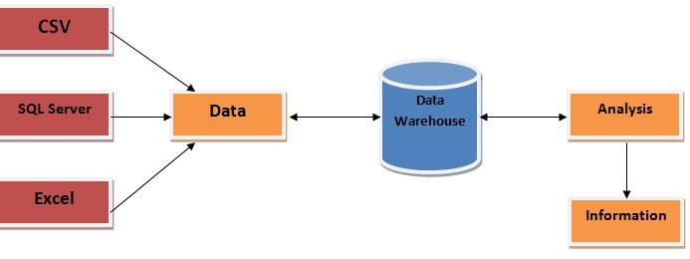
Take all the data which we have in *CSV, SQL server and Excel, dump it into some central database.

Slide 43
SQL Server Analysis Services (SSAS):
SQL Server Analysis Services (SSAS) is the technology from the Microsoft Business Intelligence stack, to develop Online Analytical Processing (OLAP) solutions.
In simple terms, you can use SSAS to create cubes using data from data marts / data warehouse for deeper and faster data analysis.
Data warehouses and Online Analytical Processing (OLAP) tools are based on a multidimensional data model.OLAP in data warehousing enables users to view data from different angles and dimensions.

Slide 44
Data Cube:
A data cube can also be described as the multidimensional extensions of two-dimensional tables. It can be viewed as a collection of identical 2-D tables stacked upon one another.
Data cubes are used to represent data that is too complex to be described by a table of columns and rows. As such, data cubes can go far beyond 3-D to include many more dimensions.
Cubes are multi-dimensional data sources which have dimensions and facts (also known as measures) as its basic constituents.

Slide 45
A data cube allows data to be viewed in multiple dimensions. A dimensions are entities with respect to which an organization wants to keep records.
For example in store sales record, dimensions allow the store to keep track of things like monthly sales of items and the branches and locations.
A data cube is generally used to easily interpret data.
It is especially useful when representing data together with dimensions as certain measures of business requirements.
From a relational perspective dimensions can be thought of as master tables and facts can be thought of as measureable details.

Slide 46
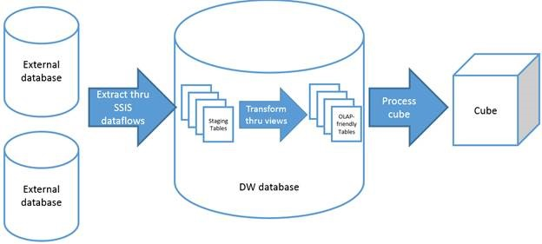

Slide 47
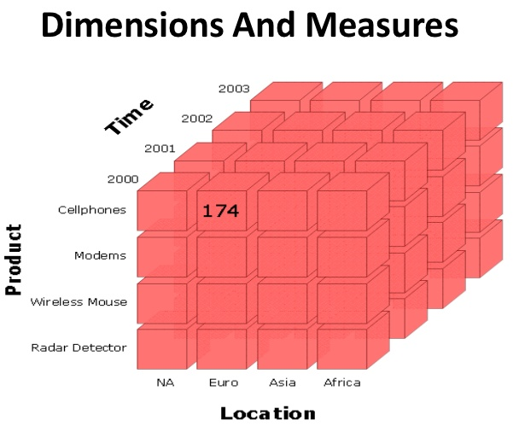
Data Cube:

Slide 48
Multidimensional Data Model:
Multidimensional data model stores data in the form of data cube. Mostly, data warehousing supports two or three-dimensional cubes.
Schemas for Multidimensional Data Model are:-
Star Schema
Snowflakes Schema
Fact Constellations Schema

